Slide 1
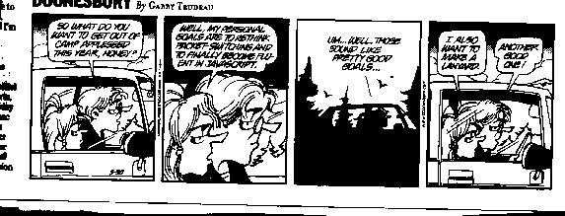
Transport Layer
Dr. Shelly Heller
sheller@gwu.edu

Slide 2
Chapter 3: Transport Layer
Chapter goals:
understand principles behind transport layer services:
  multiplexing/demultiplexing
  reliable data transfer
  flow control
  congestion control
instantiation and implementation in the Internet
Chapter Overview:
transport layer services
multiplexing/demultiplexing
connectionless transport: UDP
principles of reliable data transfer
connection-oriented transport: TCP
  reliable transfer
  flow control
  connection management
principles of congestion control
TCP congestion control

Slide 3





Transport services and protocols
provide logical communication between app’ processes running on different hosts
transport protocols run in end systems
transport vs. network layer services:
network layer: data transfer between end systems
transport layer: data transfer between processes
  relies on, enhances, network layer services
application
transport
network
data link
physical
network
data link
physical
network
data link
physical
network
data link
physical
logical end-end transport
network
data link
physical
network
data link
physical
application
transport
network
data link
physical

Slide 4
Transport-layer protocols
Internet transport services:
reliable, in-order unicast delivery (TCP)
  congestion
  flow control
  connection setup
unreliable (“best-effort”), unordered unicast or multicast delivery: UDP
services not available:
  Delay guarantee
  bandwidth guarantees
application
transport
network
data link
physical
network
data link
physical
network
data link
physical
network
data link
physical
logical end-end transport
network
data link
physical
network
data link
physical
application
transport
network
data link
physical

Slide 5
Packet Sniffing
US Wiretap law makes it illegal to intercept or procure wire, oral or electronic communication
However, it is legal to collect information radio or electronic communication through a system that is configured to be readily accessible to the general public
Court Cases
  NO! San Francisco vs Google 2011: A judge ruled that the packet sniffer used by Google Street View can be considering wiretapping
  Yes! Innovation IP Ventures vs Everyone 2012: A judge ruled that communications sent over unencrypted wireless networks as readily accessible to the public
Still a gray area, so don’t do it – This is meant for educational purposes only

Slide 6
Ports
Ssigned in three ranges
  System ports 0-1023
  User Posts 1024-49151
  Dynamic and/or private 49152-65535
Depending on use, assigned by
  System – ITEF
  User - IANA and IETF Review
  Dynamic - Not assigned
Purpose
  Communication technique for TCP and UDP
Port Scanner

Slide 7
Sockets
The principal abstraction is a socket
  Point at which an application attaches to the network
  Defines operations for creating connections, attaching to network, sending/receiving data, closing.
One endpoint of a two way communication between two programs running on the network
Bound to a port number so transport layer can identify application data sent to
An endpoint is a combination of the ip address and the port number

Slide 8
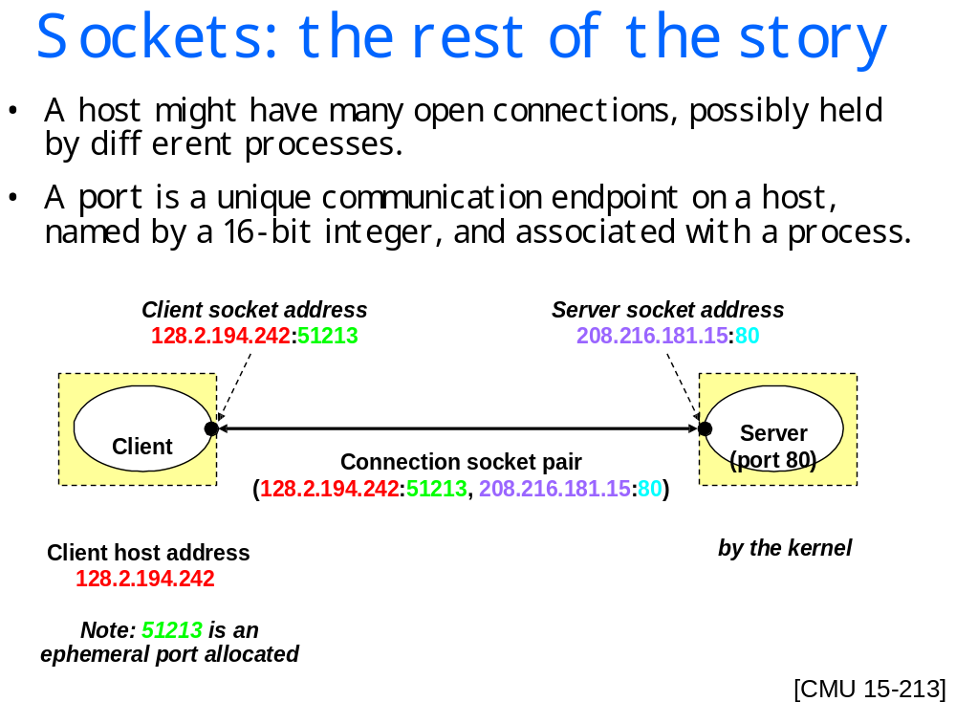

Slide 9
Ports vs Sockets
Port: A logical connection method two endpoints communicate through
Operate on the transport layer
  VPN client connects to VPN server over port 1723
Socket: One endpoint of the connection
  Means of plugging application layer into the transport layer

Slide 10
Socket Programming (Java)
Socket s = new Socket ();
To connect to a remote server need and IP address and port number
Socket s = new Socket ();
String host = www.gwu.edu// Use any IP address
try
{
s.connect (newInet(SocketAddress (host,80));
// use correct port number!

Slide 11
Sending data, closing socket
Once connected, you can send & receive data (remember to close socket)
//Send message to server //Get response from server
: String response;
//close i/o streams While ((response=s_in.readLine())
s_out.close(); !=null
in.close; {system.out.println (response);
// close the socket
s.close()

Slide 12
Server Side Sockets
A server (program) runs on a specific computer and has a socket that is bound to a specific port. The server waits and listens to the socket for a client to make a connection request.
The constructor takes two parameters – local port number and 2nd is backlog number

Slide 13
Bit more on server side sockets
If everything goes well, the server accepts the connection.
Upon acceptance, the server gets a new socket bound to a different port.
Bind socket to IP address/port
  int bind(int socket, struct sockaddr *addr, int addr_len)
Mark the socket as accepting connections
  int listen(int socket, int backlog)
“Passive open” accepts connection
  int accept(int socket, struct sockaddr *addr, int addr_len) (returns a new socket to talk to the client)
It needs a new socket (consequently a different port number) so that it can continue
to listen to the original socket for connection requests while serving
the connected client.

Slide 14
Multiplexing/demultiplexing
Multiplexing:
gathering data from multiple
app processes, enveloping
data with header (later used
for demultiplexing)
32 bits
source port #
dest. port #
other header fields
multiplexing/demultiplexing:
based on sender, receiver port numbers, IP addresses
  source, dest. port #s in each segment
  recall: well-known port numbers for specific applications
application
data
(message)
TCP/UDP segment format

Slide 15
Multiplexing/demultiplexing: examples
source port: x
dest. port: 23
Web client
host C
host A
server B
source port:23
dest. port: x
Source IP: C
dest. IP: B
source port: y
dest. port: 80
Source IP: C
dest. IP: B
source port: x
dest. port: 80
port use: simple telnet app
Source IP: A
dest. IP: B
source port: x
dest. port: 80
Web
server B
Web client
host A
port use: Web server

Slide 16
Multiplexing/demultiplexing
Recall: segment - unit of data exchanged between transport layer entities
  aka TPDU: transport protocol data unit
Demultiplexing: delivering
received segments to
correct app layer processes
receiver
P3
P4
application-layer
data
M
M
application
transport
network
segment
header
P1
P2
M
M
application
transport
network
application
transport
network
segment
H
t
M
H
segment
n

Slide 17
UDP: User Datagram Protocol [RFC 768]
“no frills,” “bare bones” Internet transport protocol
“best effort” service, UDP segments may be:
  lost
  delivered out of order to app
connectionless:
  no handshaking between UDP sender, receiver
  each UDP segment handled independently of others
Why is there a UDP?
no connection establishment (which can add delay)
simple: no connection state at sender, receiver
small segment header
no congestion control: UDP can blast away as fast as desired

Slide 18
UDP: more
often used for streaming multimedia apps
  loss tolerant
  rate sensitive
other UDP uses (why?):
  DNS
  SNMP
reliable transfer over UDP: add reliability at application layer
  application-specific error recover!
32 bits
Length, in
bytes of UDP
segment,
including
header
source port #
dest. port #
length
checksum
Application
data
(message)
UDP segment format

Slide 19
UDP checksum
Goal: detect “errors” (e.g., flipped bits) in transmitted segment
Sender:
treat segment contents as sequence of 16-bit integers
checksum: addition (1’s complement sum) of segment contents
sender puts checksum value into UDP checksum field
Receiver:
compute checksum of received segment
check if computed checksum equals checksum field value:
  NO - error detected
  YES - no error detected. But maybe errors nonetheless? More later ….

Slide 20

Principles of Reliable data transfer
important in app., transport, link layers
top-10 list of important networking topics!
characteristics of unreliable channel will determine complexity of reliable data transfer protocol (rdt)

Slide 21

Reliable data transfer: getting started
rdt_send(): called from above, (e.g., by app.). Passed data to
deliver to receiver upper layer
deliver_data(): called by rdt to deliver data to upper
send
side
receive
side
udt_send(): called by rdt,
to transfer packet over
unreliable channel to receiver
rdt_rcv(): called when packet arrives on rcv-side of channel

Slide 22
Reliable data transfer: getting started
We’ll:
incrementally develop sender, receiver sides of reliable data transfer protocol (rdt)
consider only unidirectional data transfer
  but control info will flow on both directions!
use finite state machines (FSM) to specify sender, receiver
event causing state transition
actions taken on state transition
state: when in this “state” next state uniquely determined by next event
state
1
state
2
event
actions

Slide 23
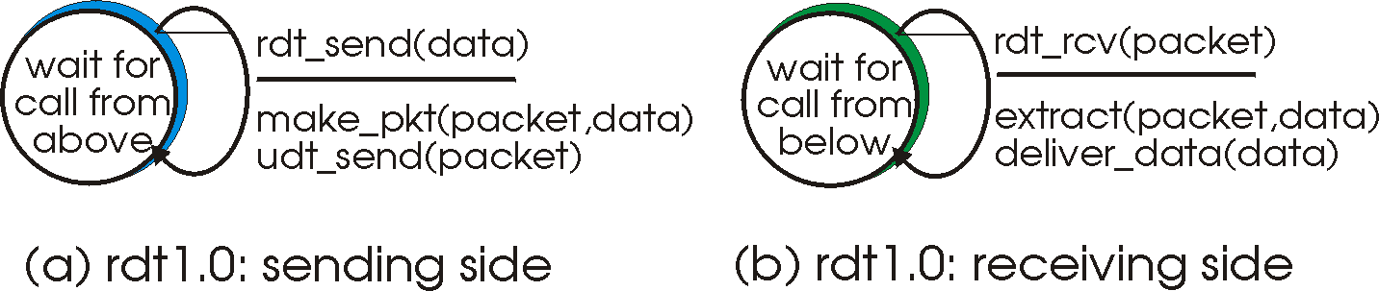
Rdt1.0: reliable transfer over a reliable channel
underlying channel perfectly reliable
  no bit errors
  no loss of packets
separate FSMs for sender, receiver:
  sender sends data into underlying channel
  receiver read data from underlying channel

Slide 24
Rdt2.0: channel with bit errors
underlying channel may flip bits in packet
  recall: UDP checksum to detect bit errors
the question: how to recover from errors:
  acknowledgements (ACKs): receiver explicitly tells sender that pkt received OK
  negative acknowledgements (NAKs): receiver explicitly tells sender that pkt had errors
  sender retransmits pkt on receipt of NAK
  human scenarios using ACKs, NAKs?
new mechanisms in rdt2.0 (beyond rdt1.0):
  error detection
  receiver feedback: control msgs (ACK,NAK) rcvr->sender

Slide 25
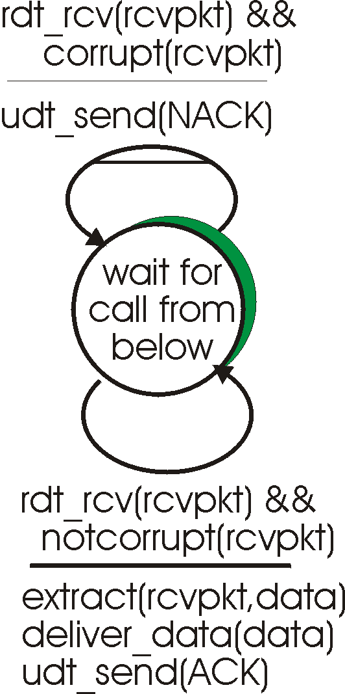
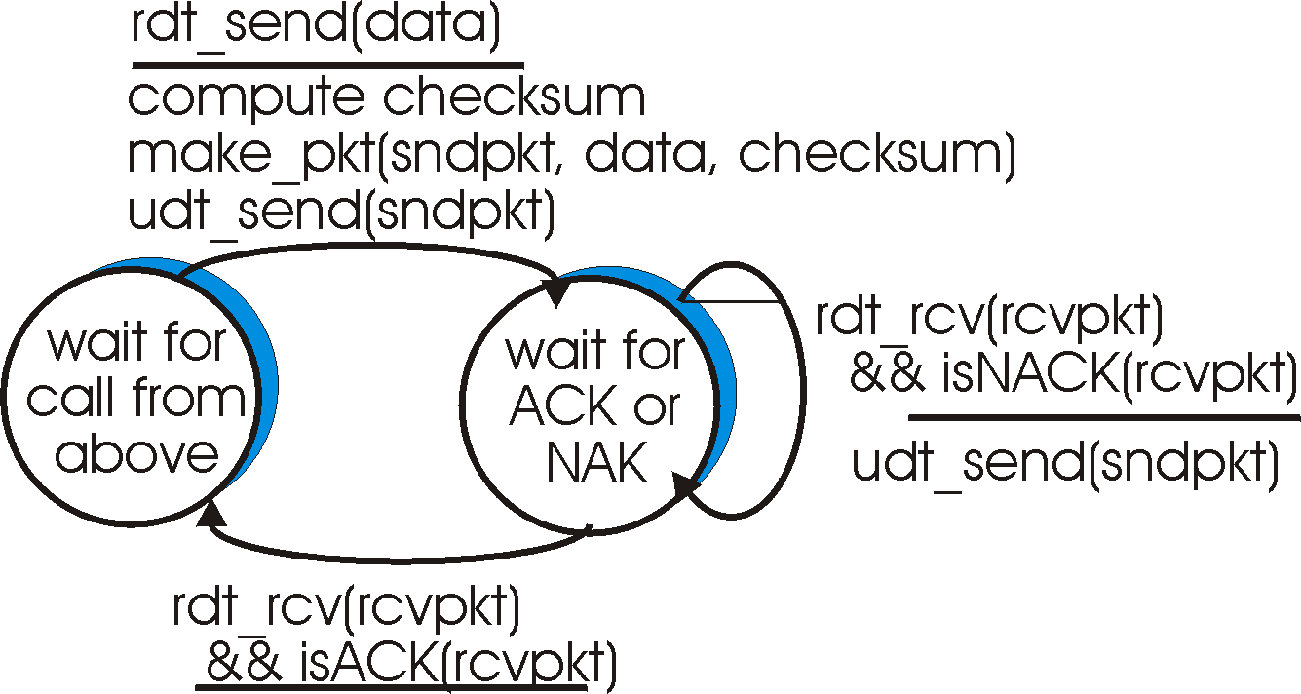
rdt2.0: FSM specification
sender FSM
receiver FSM

Slide 26
rdt2.0: in action (no errors)
sender FSM
receiver FSM

Slide 27
rdt2.0: in action (error scenario)
sender FSM
receiver FSM

Slide 28
rdt2.0 has a fatal flaw!
what happens if ACK/NAK corrupted?
sender doesn’t know what happened at receiver!
can’t just retransmit: possible duplicate
handling duplicates:
sender retransmits current pkt if ACK/NAK corrupted
sender adds sequence number to each pkt
receiver discards (doesn’t deliver up) duplicate pkt)
stop and wait
sender sends one packet,
then waits for receiver
response
Transport Layer
3-<number>

Slide 29
rdt2.1: sender, handles garbled ACK/NAKs
rdt_send(data)
sndpkt = make_pkt(0, data, checksum)
udt_send(sndpkt)
rdt_rcv(rcvpkt) &&
( corrupt(rcvpkt) ||
isNAK(rcvpkt) )
Wait for call 0 from above
Wait for ACK or NAK 0
udt_send(sndpkt)
rdt_rcv(rcvpkt)
&& notcorrupt(rcvpkt)
&& isACK(rcvpkt)
rdt_rcv(rcvpkt)
&& notcorrupt(rcvpkt)
&& isACK(rcvpkt)
Λ
Λ
Wait for ACK or NAK 1
Wait for
call 1 from above
rdt_rcv(rcvpkt) &&
( corrupt(rcvpkt) ||
isNAK(rcvpkt) )
rdt_send(data)
udt_send(sndpkt)
sndpkt = make_pkt(1, data, checksum)
udt_send(sndpkt)
Transport Layer
3-<number>

Slide 30
rdt2.1: receiver, handles garbled ACK/NAKs
rdt_rcv(rcvpkt) && notcorrupt(rcvpkt)
&& has_seq0(rcvpkt)
extract(rcvpkt,data)
deliver_data(data)
sndpkt = make_pkt(ACK, chksum)
udt_send(sndpkt)
rdt_rcv(rcvpkt) && (corrupt(rcvpkt)
rdt_rcv(rcvpkt) && (corrupt(rcvpkt)
sndpkt = make_pkt(NAK, chksum)
udt_send(sndpkt)
sndpkt = make_pkt(NAK, chksum)
udt_send(sndpkt)
Wait for
0 from below
Wait for
1 from below
rdt_rcv(rcvpkt) &&
not corrupt(rcvpkt) &&
has_seq1(rcvpkt)
rdt_rcv(rcvpkt) &&
not corrupt(rcvpkt) &&
has_seq0(rcvpkt)
sndpkt = make_pkt(ACK, chksum)
udt_send(sndpkt)
sndpkt = make_pkt(ACK, chksum)
udt_send(sndpkt)
rdt_rcv(rcvpkt) && notcorrupt(rcvpkt)
&& has_seq1(rcvpkt)
extract(rcvpkt,data)
deliver_data(data)
sndpkt = make_pkt(ACK, chksum)
udt_send(sndpkt)
Transport Layer
3-<number>

Slide 31
rdt2.1: discussion
sender:
seq # added to pkt
two seq. #’s (0,1) will suffice. Why?
must check if received ACK/NAK corrupted
twice as many states
  state must “remember” whether “expected” pkt should have seq # of 0 or 1
receiver:
must check if received packet is duplicate
  state indicates whether 0 or 1 is expected pkt seq #
note: receiver can not know if its last ACK/NAK received OK at sender
Transport Layer
3-<number>

Slide 32
rdt2.2: a NAK-free protocol
same functionality as rdt2.1, using ACKs only
instead of NAK, receiver sends ACK for last pkt received OK
  receiver must explicitly include seq # of pkt being ACKed
duplicate ACK at sender results in same action as NAK: retransmit current pkt
Transport Layer
3-<number>

Slide 33
rdt2.2: sender, receiver fragments
rdt_send(data)
sndpkt = make_pkt(0, data, checksum)
udt_send(sndpkt)
rdt_rcv(rcvpkt) &&
( corrupt(rcvpkt) ||
isACK(rcvpkt,1) )
Wait for call 0 from above
Wait for ACK
0
udt_send(sndpkt)
sender FSM
fragment
rdt_rcv(rcvpkt)
&& notcorrupt(rcvpkt)
&& isACK(rcvpkt,0)
rdt_rcv(rcvpkt) &&
(corrupt(rcvpkt) ||
has_seq1(rcvpkt))
Λ
Wait for
0 from below
receiver FSM
fragment
udt_send(sndpkt)
rdt_rcv(rcvpkt) && notcorrupt(rcvpkt)
&& has_seq1(rcvpkt)
extract(rcvpkt,data)
deliver_data(data)
sndpkt = make_pkt(ACK1, chksum)
udt_send(sndpkt)
Transport Layer
3-<number>

Slide 34
rdt3.0: channels with errors and loss
new assumption: underlying channel can also lose packets (data, ACKs)
  checksum, seq. #, ACKs, retransmissions will be of help … but not enough
approach: sender waits “reasonable” amount of time for ACK
retransmits if no ACK received in this time
if pkt (or ACK) just delayed (not lost):
  retransmission will be duplicate, but seq. #’s already handles this
  receiver must specify seq # of pkt being ACKed
requires countdown timer
Transport Layer
3-<number>

Slide 35
rdt3.0 sender
rdt_send(data)
rdt_rcv(rcvpkt) &&
( corrupt(rcvpkt) ||
isACK(rcvpkt,1) )
sndpkt = make_pkt(0, data, checksum)
udt_send(sndpkt)
start_timer
rdt_rcv(rcvpkt)
Λ
Λ
Wait for
call 0from above
Wait for ACK0
timeout
udt_send(sndpkt)
start_timer
rdt_rcv(rcvpkt)
&& notcorrupt(rcvpkt)
&& isACK(rcvpkt,1)
rdt_rcv(rcvpkt)
&& notcorrupt(rcvpkt)
&& isACK(rcvpkt,0)
stop_timer
stop_timer
Wait for ACK1
Wait for
call 1 from above
timeout
udt_send(sndpkt)
start_timer
rdt_rcv(rcvpkt)
rdt_send(data)
Λ
rdt_rcv(rcvpkt) &&
( corrupt(rcvpkt) ||
isACK(rcvpkt,0) )
sndpkt = make_pkt(1, data, checksum)
udt_send(sndpkt)
start_timer
Λ
Transport Layer
3-<number>

Slide 36

rdt3.0 in action
sender
receiver
sender
receiver
send pkt0
pkt0
send pkt0
pkt0
rcv pkt0
rcv pkt0
ack0
send ack0
ack0
send ack0
rcv ack0
rcv ack0
send pkt1
pkt1
send pkt1
pkt1
rcv pkt1
X
ack1
send ack1
loss
rcv ack1
send pkt0
pkt0
rcv pkt0
timeout
resend pkt1
ack0
send ack0
pkt1
rcv pkt1
ack1
send ack1
rcv ack1
send pkt0
pkt0
(a) no loss
rcv pkt0
ack0
send ack0
(b) packet loss
Transport Layer
3-<number>

Slide 37
rdt3.0 in action
sender
receiver
sender
receiver
send pkt0
pkt0
send pkt0
pkt0
rcv pkt0
rcv pkt0
ack0
send ack0
send ack0
rcv ack0
ack0
send pkt1
pkt1
rcv ack0
rcv pkt1
send pkt1
pkt1
send ack1
rcv pkt1
ack1
send ack1
ack1
X
loss
timeout
resend pkt1
pkt1
rcv pkt1
timeout
resend pkt1
rcv ack1
pkt1
rcv pkt1
pkt0
(detect duplicate)
send pkt0
send ack1
ack1
(detect duplicate)
ack1
rcv pkt0
rcv ack1
send ack1
rcv ack1
ack0
send ack0
pkt0
send pkt0
pkt0
send pkt0
rcv pkt0
rcv pkt0
ack0
(detect duplicate)
ack0
send ack0
send ack0
(c) ACK loss
(d) premature timeout/ delayed ACK
Transport Layer
3-<number>

Slide 38

Performance of rdt3.0
rdt3.0 is correct, but performance stinks
e.g.: 1 Gbps link, 15 ms prop. delay, 8000 bit packet:
L
8000 bits
D_{trans} =
=
=
8 microsecs
R
10⁹ bits/sec
  U _{sender}: utilization – fraction of time sender busy sending
  if RTT=30 msec, 1KB pkt every 30 msec: 33kB/sec thruput over 1 Gbps link
network protocol limits use of physical resources!
Transport Layer
3-<number>

Slide 39
rdt3.0: stop-and-wait operation
sender
receiver
first packet bit transmitted, t = 0
last packet bit transmitted, t = L / R
first packet bit arrives
RTT
last packet bit arrives, send ACK
ACK arrives, send next
packet, t = RTT + L / R
Transport Layer
3-<number>

